Slide 1


DESCRIPTIVE STATISTICS AND PROBABILITY
Dr. Imen GAM Level: Undergraduate – Year 1, Business Intelligence specialization
2026/2027

Slide 2
Plan
Introduction to descriptive statistics
Statistical series presentation
Single-Character Statistical Distributions Characteristics
Introduction to probability calculation

Slide 3
Part 1: Introduction to descriptive statistics
1. Course Overview
2. Statistical Terminology – Core Concepts

Slide 4
1. Course Overview
Definition
Descriptive Statistics is the branch of statistics that focuses on summarizing and describing the essential features of a dataset.
It uses tables, numerical indicators, and graphical representations to present data clearly and effectively.
Two Branches of Statistics
Descriptive Statistics: Collection, organization, summary, and presentation of data.
Inferential Statistics: Uses probability theory to make predictions or decisions about a population from a sample.

Slide 5
2. Statistical Terminology
Core Concepts
Term | Definition | Example
Population | All units | All students at PRISTINI AI
Sample | Subset of population | 8 students from a class of 30
Statistical Unit | Element observed | A student

Slide 6
2. Statistical Terminology
Statistical Variables (Characteristics)
Definition
A statistical variable is a feature or attribute measured on each unit in a study.
Types:
Qualitative Variable: Non-numerical (e.g., eye color, nationality)
  Nominal: unordered (e.g., gender)
  Ordinal: ordered (e.g., education level)
Quantitative Variable: Numerical
  Discrete: finite/countable (e.g., number of children)
  Continuous: measurable (e.g., weight, income)

Slide 7
2. Statistical Terminology
Statistical Variables (Characteristics)
Type | Description | Example
Qualitative Nominal | Unordered | Eye color
Qualitative Ordinal | Ordered | Level of education
Quantitative Discrete | Countable | Number of children
Quantitative Continuous | Measurable | Height, income

Slide 8
2. Statistical Terminology
Statistical Variables (Characteristics)
Modalities of a Variable
Definition
Modalities are the distinct values or categories a variable can take.
Rules:
Incompatibility: A unit cannot belong to two modalities at once.
Exhaustiveness: Every unit must fit into one of the listed modalities.
Example:
For the variable phone color, possible modalities could be: red, black, white.

Slide 9
2. Statistical Terminology
Census vs. Sampling
Census | Sampling
Full population study | Subset study
Costly and time-consuming | Less expensive, quicker
More accurate | Requires representativity
Types of Sampling:
Quota sampling
Simple random sampling
Stratified sampling
Judgement (reasoned) sampling
…
Notes:
.

Slide 10
2. Statistical Terminology
Frequency and Count
Count (nᵢ): Number of units per modality
Absolute Frequency = nᵢ
Relative Frequency = nᵢ / N with N=∑ nᵢ
Example:
6 students have black phones → nᵢ = …………
If 10 students are surveyed → fᵢ = ……………. Or …………..%

Slide 11
Applications
Multiple Choice (QCM)
Q1. What is the main goal of descriptive statistics?
A. Predict future data outcomes
B. Describe a large amount of data concisely and meaningfully
C. Identify cause-effect relationships
D. Infer conclusions from samples to populations
Q2. Which of the following is not a feature of descriptive statistics?
A. Summarizing data using graphs
B. Making predictions based on probabilities
C. Calculating frequencies and averages
D. Organizing data in tables

Slide 12
Applications
Read each statement and mark it as TRUE or FALSE:
A "population" is a subset of the sample.
A "unit" is one element from the population.
Variables can be both qualitative and quantitative.
An "ordinal variable" has non-ranked modalities.
A "discrete variable" can take an infinite number of values.
6. A recensement (census) is always preferable to a survey because it provides more accurate data.
7. A character must be numeric to be studied statistically.
8. A modality of a variable must be both exhaustive and mutually exclusive.
9. A statistical unit can have more than one modality for the same variable.
10. A variable can be both qualitative and continuous.

Slide 13
Applications
Scenario: A university is analyzing the types of laptops used by its 1,200 students. A survey is conducted on 150 randomly selected students, recording their laptop brands (HP, Dell, Apple, Asus, Others).
Identify the different Key Elements from this Scenario (population, sample, statistical unit, variable, modalities, nature of the variable)

Slide 14
Applications
Complete the table
Variable | Type | Subtype
Eye color | ? | ?
Monthly salary | ? | ?
Level of satisfaction (low/medium/high) | ? | ?
Number of children in a family | ? | ?
Blood type (A, B, AB, O) | ? | ?
Height in cm | ? | ?

Slide 15
Applications
Find Errors in a Table
Age of student | Number of Students
[18,20[ | 5
[20,21[ & [21,22[ | 3
[22,24[ | 7
[24,28[ | 4
> 200 | 1

Slide 16
Applications
Scenario A: A university wants to find the most common laptop brand among its 100,000 alumni.
Scenario B: A manager wants to determine the salary structure of the 25 employees in his department.
Questions:
In which scenario is a census more appropriate?
In which scenario is a sample more practical?
Explain why for each.

Slide 17
Applications
Match concepts with their definitions.
Term | Definition Letter
Population | A specific value taken by a variable
Statistical unit | Subset selected from a larger group
Variable | Entire group under study
Modality | A characteristic measured on each element
Sample | Individual element of the group

Slide 18
Applications
Scenario:
A marketing agency wants to study the coffee consumption habits of employees in tech startups across France. They select 200 employees from various companies to answer questions like age, job title, cups of coffee per day, and coffee brand preference.
Questions:
Identify the statistical population.
What is the sample?
Give two examples of qualitative variables in this study.
Give two examples of quantitative variables (discrete or continuous).
For the variable "cups of coffee per day", is it discrete or continuous? Justify.

Slide 19
Applications
Given: A group of 20 students were surveyed on the number of languages they speak. Compute frequencies.
Languages Spoken | Count (nᵢ) | Relative Frequency (fᵢ)
1 | 6 | ?
2 | 10 | ?
3 | 4 | ?
Total | 20 | 1.00

Slide 20
Part 2: Statistical series presentation
Statistical series presentation is the first step in any statistical analysis.
Two main presentation types:
Tables
Graphs
The choice depends on the objective of the study.

Slide 21
1. Quantitative Data Distributions
Types of quantitative variables:
Discrete variables
Continuous variables
Each requires specific types of tables and graphical representations.

Slide 22
1. Quantitative Data Distributions Discrete variables
Variables that take countable values (e.g.: number of children).
Represented using simple tables with:
Values of the variable ​
Frequencies ​

Slide 23
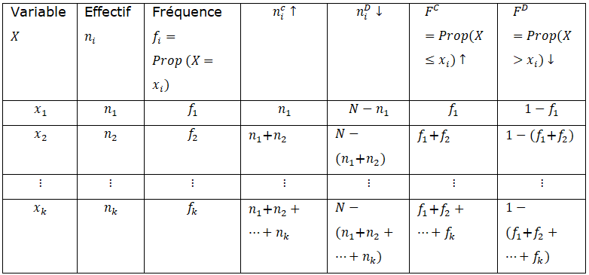
1. Quantitative Data Distributions Discrete variables
Table Structure for Discrete Variables
Table Columns:
Variable X_{i} Frequency n_{i} Relative frequency fi=(n_{i} /N)
Cumulative frequency n_{i}^{c}​ Descending cumulative frequency n_{i}^{D} ​
Cumulative relative frequency F^{c} Descending cumulative frequency F^{D}

Slide 24


1. Quantitative Data Distributions Discrete variables
Cumulative Frequency F(x)
Definition:
Represents proportion of individuals with X ≤ x
Also called distribution function
Mathematical Form:
Properties:

Slide 25

1. Quantitative Data Distributions Discrete variables
Descending Cumulative Frequency
Definition
Represents proportion of individuals with X>x
Formula
F^{D}(x)= 1−F(x)

Slide 26
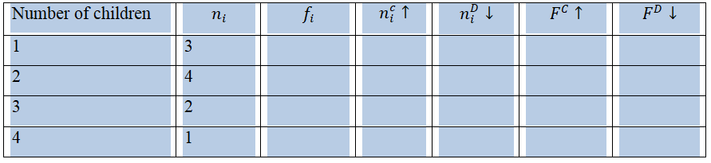
1. Quantitative Data Distributions Discrete variables
Example – Number of Children per Household
Let there be 10 households. The concept of cumulative frequency allows us to answer questions such as 'determine the proportion of households with more than 2 children' or 'with fewer or equal than 3 children'

Slide 27
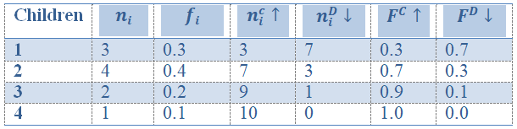
1. Quantitative Data Distributions Discrete variables
Solution
R Code for Discrete Frequency Analysis
> X=c(1,1,1,2,2,2,2,3,3,4)
> T=table(X)
>V=c(T) >data.frame(Eff=V,EffCum=cumsum(V),Freq=V/sum(V),FreqCum=cumsum(V/sum(V)))

Slide 28
1. Quantitative Data Distributions Discrete variables
Graphical Representation: Discrete Variables
Types:
Bar chart (differential diagram): represents frequencies or counts
Cumulative graph (integral diagram): shows cumulative frequencies
R Code: Frequency and Count Bar Charts
Freq = V/sum(V) plot(Freq, type="h", lwd=3) # Frequency bars
plot(T, type="h", lwd=3) # Count bars plot(ecdf(X),xlab="",ylab="",main="",frame=0) # integral diagram
Application
Plot the three graphs related to the previous application

Slide 29
1. Quantitative Data Distributions Continuous variables
Definition:
Can take infinite values
Data must be grouped into intervals:
[e _{i-1} ,e _{i}[
Concepts:
  Class center: c _{i} = (e _{i-1} + e _{i})/2
  Class width: a _{i} = e _{i} - e _{i-1} ​

Slide 30
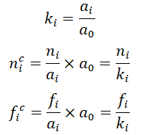
1. Quantitative Data Distributions Continuous variables
Continuous Variable Table Structure
Columns:
Class interval
Center c_{i}​
Frequency n_{i}
Relative frequency f_{i}
Cumulative values n_{i}^{c}, f_{i}^{c} ​, etc.
Corrected Frequencies for Unequal Classes
Steps:
1- Choose smallest class width a₀
2- Calculate:

Slide 31
1. Quantitative Data Distributions Continuous variables
Graphs for Continuous Variables
Types:
Histogram: for frequencies/counts
Polygon: connect centers of histogram bars
Cumulative curve: shows cumulative distribution

Slide 32
1. Quantitative Data Distributions Continuous variables
Example:
The heights of 30 students in a class are measured in centimeters:
152 | 152 | 152 | 153 | 153 | 154
154 | 154 | 154 | 155 | 153 | 155
160 | 161 | 160 | 160 | 163 | 165
161 | 161 | 161 | 165 | 165 | 157
157 | 159 | 163 | 164 | 164 | 165
1- Group data into equal-width classes of 4 cm
2- Create frequency table
3- Plot histogram, polygon, and cumulative curve

Slide 33
1. Quantitative Data Distributions Continuous variables
R Code
>X=c(152,152,152,153,153,154, 154, 154, 154, 155, 153, 155, 160, 161, 160, 160, 163, 165, 161, 161, 161, 165, 165, 157, 157,159, 163, 164, 164, 165)
>T=table(cut(X, breaks=c(151,155,159,163,167)))
>V=c(T)
> data.frame(Eff=V,EffCum=cumsum(V),Freq=V/sum(V),FreqCum=cumsum(V/sum(V)))
> hist(X,breaks=c(151,155,159,163,167), freq=FALSE, xlab="",ylab="",main="",xaxt = "n")
>hist(X,breaks=c(151,155,159,163,167), freq=TRUE, xlab="",ylab="",main="",xaxt = "n") # Histogram of frequency
> axis(1, c(151,155,159,163,167))
# Cumulative Curve
> y=c(0,0,cumsum(V/sum(V)),1)
> x=c(147,151,155,159,163,167,181)
> plot(x,y,type="b",xlab="",ylab="",xaxt = "n")
> axis(1, c(147,151,155,159,163,167,181))

Slide 34
2- Qualitative Variables
Types:
Nominal: no order (e.g., nationality)
Ordinal: with order (e.g., grades)
Table should include:
Modalities
Frequencies n_{i}
Relative frequencies f_{i}

Slide 35
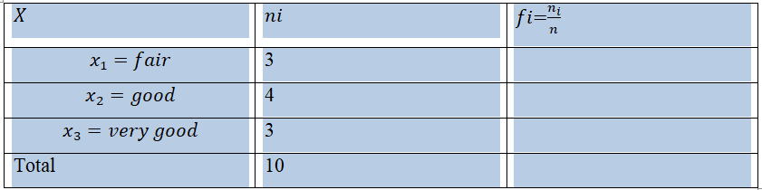
2- Qualitative Variables
Example
The focus is on the variable 'Grade obtained', denoted X, based on the data from 10 students. The statistical table is shown below:

Slide 36
2- Qualitative Variables
Graphical Representation
Types:
Bar chart (organ pipes)
Pie chart (sector diagram)
Remark: In order to construct the pie chart, the angle corresponding to each category must be calculated using the formula:
aᵢ = fᵢ × 360°
R Code:
>X=c('fair', 'fair', 'fair', 'good', 'good', 'good', 'good', 'very good', 'very good', 'very good’)
>T=table (X)
>V=c(T)
>data.frame(Eff=V,freq=V/sum(V))
> barplot(T) # Bar Chart
> pie(T,radius=1) # Pie Chart

Slide 37
Applications
True or False Questions
A characteristic can only be studied either as discrete or as continuous.
The frequency is the numerical expression of the characteristic.
A statistical unit can include one or several modalities.
It is preferable to conduct a sample survey rather than a census if one wishes to obtain a significant study at lower cost.
The representation of continuous variables is a bar chart.
In a pie chart, it is easy to represent either a discrete or a continuous variable.

Slide 38
Applications
Application 2
Given the series showing the grades obtained by a class of 22 IHEC students: 10, 16, 16, 12, 14, 14, 16, 20, 11, 10, 10, 8, 8, 7, 7, 15, 12, 13, 18, 17, 9, 9.
1- Construct the table presenting the series in a discrete form, along with the cumulative ascending and descending frequencies.
2- Present the same series in a continuous form, with the corresponding cumulative frequencies.

Slide 39
Part 3: Single-Character Statistical Distributions Characteristics
1- Measures of central tendency
2- Measures of dispersion
3- Measures of shape
4- Measures of concentration

Slide 40
1- Measures of central tendency
Definition:
They give information about the center or average of the data. Also called position parameters.
Main indicators:
Mode (Mo)
Median (Me)
Quantiles
Mean (Arithmetic, Geometric, Harmonic)

Slide 41
1- Measures of central tendency Mode
Definition:
The mode is the value (or class) with the highest frequency or count. It represents the most frequent observation.
Notation: Mo
Example (Discrete Case):
xᵢ | nᵢ | fᵢ
0 | 2 | 0.2
1 | 2 | 0.2
2 | 4 | 0.4
3 | 2 | 0.2
The highest relative frequency = 0.4 (for x = 2) confirming that Mo = 2 children per family
Graphically: The mode corresponds to the tallest bar in a bar chart.

Slide 42


1- Measures of central tendency Mode
Case of Continuous Variables
Step 1: Identify the modal class: the class with the highest frequency.
Two cases:
Equal class widths: modal class = highest frequency
Unequal class widths: modal class = highest density
Formula:
where:
x_{inf} = lower bound of modal class
a = class width
d₁ = f(modal) − f(previous)
d₂ = f(modal) − f(next)

Slide 43
1- Measures of central tendency Mode
Example:
Class | nᵢ | fᵢ
[500–600[ | 3 | 0.1
[600–700[ | 6 | 0.2
[700–800[ | 18 | 0.6
[800–900[ | 3 | 0.1
Modal class = [700–800[
x₍inf₎ = 700, a = 100
d₁ = 0.6 − 0.2 = 0.4
d₂ = 0.6 − 0.1 = 0.5
Mode ≈ 744.4

Slide 44

1- Measures of central tendency Median
Definition:
The median (Me) divides the ordered data into two equal parts:
50% of values are below,
50% are above.

Slide 45


1- Measures of central tendency Median
Median for Discrete Data
Two situations:
Odd number of observations (n = 2m + 1):
Even number of observations (n = 2m):
Example:
Series 1: 14, 15, 9, 18, 10, 15, 19, 12, 13, 14
Series 2: Add one more value (10)

Slide 46

1- Measures of central tendency Median
Median for Continuous Data
Find the median class (where cumulative frequency ≥ 0.5).
Apply linear interpolation:
Example:
Class | nᵢ
[600–800[ | 5
[800–1000[ | 13
[1000–1200[ | 19
[1200–1400[ | 3
Total = 40

Slide 47
2- Measures of dispersion
Measures of central tendency (mean, median, mode) give the average level of data but they don’t tell us how data are spread around that center.
To fully describe a dataset, we also need dispersion measures, which show how close or far data are from the central value.
Dispersion helps compare datasets with the same mean but different variability

Slide 48

2- Measures of dispersion Range
Definition:
The range (E) is the difference between the largest and smallest observed values.
Example:
Data: 5, 6, 3, 8, 10, 15
E=15−3=12
Properties:
Very easy to calculate.
Gives a quick idea of the data spread.
However: depends heavily on extreme values, so it may be misleading.

Slide 49

2- Measures of dispersion Mean Absolute Deviation (MAD)
Definition:
The Mean Absolute Deviation (eₘ) is the average of the absolute differences between each value and the mean.
If data are grouped, use class midpoints.
Example:
Class | nᵢ
[600–800[ | 5
[800–1000[ | 13
[1000–1200[ | 19
[1200–1400[ | 3
Total = 40
 | 5
 | 13
 | 19
 | 3
Total | 40

Slide 50

2- Measures of dispersion Mean Absolute Deviation (MAD)
Alternative:
MAD around the median:
Advantages:
Uses all values of the dataset.
Drawback:
Absolute values complicate algebraic calculations: Variance solves this issue.

Slide 51


2- Measures of dispersion Variance
Definition:
Variance measures the average squared deviation from the mean.
Squaring removes the sign effect.
For ungrouped data:
For grouped data:
Example:
Compute variance for salary distribution.
Note:
Variance is also called mean square deviation.

Slide 52

2- Measures of dispersion Standard Deviation
Definition:
The standard deviation (σ) is the square root of variance:
It expresses dispersion in the same units as the variable.
Interpretation:
The greater σ, the more the values deviate from the mean.
Essential for comparing variability in data.

Slide 53

2- Measures of dispersion Coefficient of Variation
Problem: Variance and σ depend on measurement units.
Solution: Use a unit-free measure: the Coefficient of Variation (CV).
Example:
We want to compare two distributions of weekly net profits in euros for two stores, over a period of 100 weeks.
Store 1 |  |  | Store 2
Profits |  |  | Profits
1000 | 10 |  | 11000 | 8
2000 | 25 |  | 12000 | 24
3000 | 37 |  | 13000 | 38
4000 | 21 |  | 14000 | 20
5000 | 7 |  | 15000 | 10
 | 100 |  |  | 100

Slide 54
2- Measures of dispersion Coefficient of Variation
Solution:
Statistic | Store 1 | Store 2
Mean (𝑋̄) | 2,900 | 13,000
σ | 1,063 | 1,077
CV | 36.65% | 8.28%
Interpretation:
Although both σ are similar, Store 1’s profits are more variable relative to its mean.
The CV captures relative dispersion effectively.

Slide 55
3- Shape Characteristics
Definition:
Beyond central tendency and dispersion, shape characteristics describe the general form of a frequency distribution without drawing it.
Two main aspects:
Asymmetry (Skewness): How data are distributed around the center.
Flatness (Kurtosis): How peaked or flat the curve is.

Slide 56
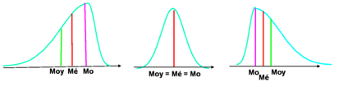
3- Shape Characteristics
Asymmetry: Comparing Mean, Median, Mode
The relative positions of mean (𝑋̄), median (Me), and mode (Mo) reveal skewness:
Case | Relation | Type of Distribution
1 | Mo < Me < 𝑋̄ | Right-skewed (tail on the right)
2 | Mo = Me = 𝑋̄ | Perfectly symmetrical
3 | Mo > Me > 𝑋̄ | Left-skewed (tail on the left)

Slide 57
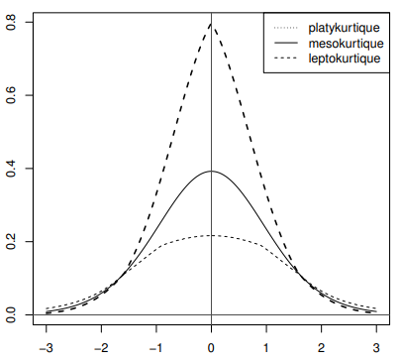

3- Shape Characteristics
Kurtosis (Flatness)
Definition:
Kurtosis measures how “peaked” or “flat” a distribution is compared to the normal curve.
Pearson’s coefficient:

Slide 58
3- Shape Characteristics
Kurtosis (Flatness)
Type | Condition | Description
Mesokurtic | (A_{p} = 3) | Normal curve
Leptokurtic | (A_{p} > 3) | More peaked
Platykurtic | (A_{p} < 3) | Flatter

Slide 59
Part 4: Probability Dostributions
Learning Objectives:
Understand the main discrete and continuous probability distributions.
Identify the appropriate law for a given random experiment.
Calculate the key parameters: expectation, variance, etc.
Apply these laws in real-life examples.
Two types of random variables:
Discrete: takes countable values (0,1,2,…).
e.g. number of successes, number of calls, etc.
Continuous: takes infinitely many values in an interval.
e.g. height, duration, weight, etc.

Slide 60


1- Discrete probability distributions Bernoulli Distribution
Definition
A random variable X follows a Bernoulli distribution with parameter p (where 0<p<1) if:
We write
Interpretation:
Two opposite outcomes:
  Success (1) with probability p.
  Failure (0) with probability q=1−p.

Slide 61

1- Discrete probability distributions Bernoulli Distribution
Explanation
X | 0 | 1
P(X=x) | 1−p | p
Properties
Expected value: E(X)=p
Variance: V(X)=p(1−p)
Remark:
If Z,W∼B(p) and are independent, then U=Z+W is not Bernoulli.

Slide 62
1- Discrete probability distributions Bernoulli Distribution
Example:
At a vehicle inspection center, define X=1 if a car passes, and X=0 if it fails. The rejection rate is 0.1.
1- What is the probability distribution followed by X? Specify its parameters.
2- Compute the expected value (mathematical expectation) of X as well as its variance.

Slide 63




1- Discrete probability distributions Bernoulli Distribution
Solution
1- The experiment has two opposite results: success (the car is accepted) with probability 0.9, and failure (the car is rejected) with probability 0.1. Therefore, X follows a Bernoulli distribution with parameter p = 0.9.
2-

Slide 64


1- Discrete probability distributions Binomial Distribution
Experiment setup:
n independent Bernoulli trials, each with success probability p.
X: number of successes among the n trials.
Probability Distribution:
Notation: X∼B(n,p)
Note:
For n=1, B(1,p)=B(p).

Slide 65
1- Discrete probability distributions Binomial Distribution
Properties
Expected value: E(X)=np
Variance: V(X)=npq
Additivity Property:
If Z∼B(n ₁ ,p) and W∼B(n ₂ ,p). Z and W are independent, then:
Z+W∼B(n ₁+n ₂,p)

Slide 66




1- Discrete probability distributions Binomial Distribution
Example 1:
Determine the probability distributions of a Binomial from the following representations:

Slide 67
1- Discrete probability distributions Binomial Distribution
Example 2:
6% of Tunisians are customers of the mobile network operator “ORANGE.” During a survey, 50 Tunisians are asked about their mobile network operator. The random variable X represents the number of ORANGE customers among the 50 individuals.
1- Determine, with justification, the probability distribution of X.
2- What is the probability that the 6% proportion is observed in the outcome of the survey?
3- What is the probability that none of the 50 individuals is an ORANGE customer?
4- What is the probability that there are at least four ORANGE customers?
5- What is the probability that there are more than 10 ORANGE customers?

Slide 68


1- Discrete probability distributions Poisson Distribution
Definition
A random variable X follows a Poisson distribution with parameter λ > 0 if:
Its possible values are: Ωₓ = {0, 1, 2, 3, …}
Its probability mass function is:
Notation:

Slide 69
1- Discrete probability distributions Poisson Distribution
When do we use the Poisson distribution?
The Poisson distribution models the number of occurrences of a rare and independent event over a fixed interval of time, area, or volume.
Typical applications:
Number of phone calls received per time unit
Number of defects in a production line
Number of customers arriving in a queue
Number of accidents per day on a highway
Number of breakdowns of a machine per month
Poisson : counting rare, independent events

Slide 70
1- Discrete probability distributions Poisson Distribution
The Parameter λ
λ is the expected number of events in the given interval
A higher λ shifts the distribution toward larger values
λ is both the mean and the variance
Characteristics
Expected value: E(X)=λ
Variance: Var(X)=λ
The Poisson distribution is one of the few distributions where mean = variance.

Slide 71


1- Discrete probability distributions Poisson Distribution
Sum of Poisson Variables
Stability Property
If:
with X and Y independent, then:
More generally:

Slide 72
1- Discrete probability distributions Poisson Distribution
Aspect | Binomial | Poisson
Variable type | Number of successes out of n trials | Number of events in a continuous interval
Maximum value | N (fixed number of trials) | Infinite (No fixed number of trials)
When appropriate | Fixed sample size | Events in time/space
“Rare event” situation | No | Yes — by definition
Example: Defective items | Inspect n = 100 pieces manufactured. Each piece independently has probability p = 0.02 of being defective. The number of defective pieces is Binomial(100, 0.02) You have a fixed sample size and want to know how many are defective. | In a continuous production process producing thousands of pieces, defects occur randomly and rarely at an average rate λ = 2 defects per hour. The number of defects in one hour is Poisson(λ = 2) You count defects over time, and their occurrence is rare and random.

Slide 73
1- Discrete probability distributions Poisson Distribution
Poisson as an approximation to the Binomial distribution
A binomial random variable B(n,p) can be approximated by a Poisson distribution if:
n > 30
p < 0.1
np < 10
In this case: λ=np
This approximation is widely used in practice.

Slide 74
1- Discrete probability distributions Poisson Distribution
Problem Statement
On a highway, two toll booths A and B operate.
Let XA​ and XB​ be the number of cars served in 5 minutes.
Given:
Average at booth A: 3 cars: XA∼P(3)
Average at booth B: 2 cars: XB∼P(2)
Services are independent
We want to compute: P(X>3) where X=XA+XB

Slide 75
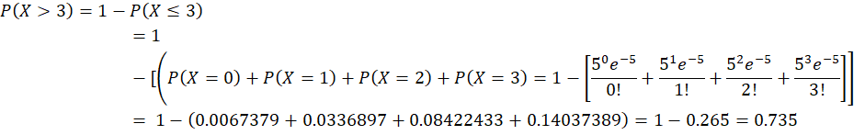
1- Discrete probability distributions Poisson Distribution
Solution
1- Sum of the two Poisson variables:
X=XA+XB∼P(3+2)=P(5)
2- We compute:

Slide 76
1- Discrete probability distributions Applications
Application 1:
Let X1,X2,…,Xn be an i.i.d. sample where each Xi follows a Bernoulli distribution with parameter 1/5.
1- Determine the expression of the probability function of Xi​.
2- Determine the expected value and the variance of Xi​.
3- Let Y=X1+X2​. Identify the probability distribution of Y, and determine its expected value and its variance.
4- Let Z=∑Xi. Identify the probability distribution of Z and write its probability density function.

Slide 77
1- Discrete probability distributions Applications
Application 2:
A survey conducted at a university showed that 7% of the students had high-speed Internet access. A sample of 100 students is questioned. Let X be the random variable representing the number of students who have high-speed Internet access.
1- Explain why X follows a binomial distribution and specify its parameters.
2- Compute the probability P(X=5).
3- We assume that X can be approximated by a random variable X1​ following a Poisson distribution.
a. What is the parameter of this Poisson distribution?
b. Determine the probabilities P(X1=5) and P(X1>7).
c. Determine the probability that there are at most 5 students with high-speed Internet access.

Slide 78
2- Continuous Probability Distributions The Normal Distribution
Also called:
Gaussian Distribution
Laplace–Gauss Distribution
Why is it so important?
Models a large variety of natural random phenomena
Serves as limiting law of averages (Central Limit Theorem)
Many statistical methods are based on it
Many distributions can be approximated by the Normal law under certain conditions

Slide 79





2- Continuous Probability Distributions The Normal Distribution
A random variable X follows a Normal distribution with parameters
and if its density is:
Notation:

Slide 80
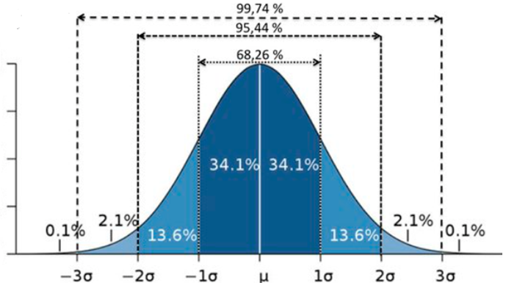
2- Continuous Probability Distributions The Normal Distribution
Shape of the Density
Key Visual Characteristics
Bell-shaped curve
Symmetric around the mean μ
Single peak at x=μ
Tails decrease rapidly but never touch zero
Around 68% of the data lie within the interval [μ − σ, μ + σ], 95% lie within [μ − 2σ, μ + 2σ], and 99.7% lie within [μ − 3σ, μ + 3σ].

Slide 81



2- Continuous Probability Distributions The Normal Distribution
Application:
Determine if each density corresponds to a Normal distribution.

Slide 82


2- Continuous Probability Distributions The Normal Distribution
Stability Under Addition
If
and X, Y are independent:
This property is essential in signal processing, risk aggregation, and measurement theory.
Properties

Slide 83



2- Continuous Probability Distributions The Normal Distribution
The Standard Normal Distribution
Given:
Define:
​
Then:
We compute probabilities using standard normal tables.
The table gives values of: F(z)=P(Z≤z)

Slide 84
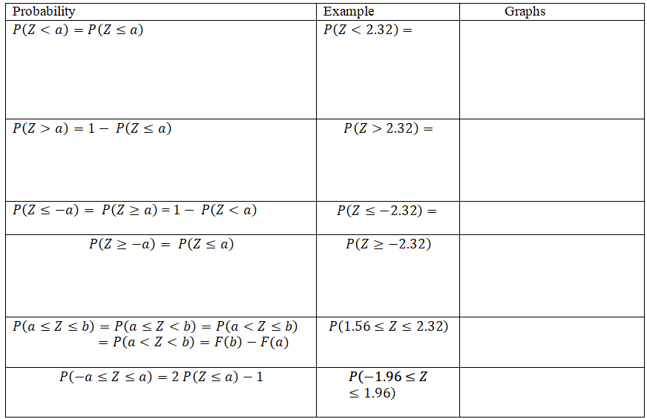
2- Continuous Probability Distributions The Normal Distribution
Probability Rules:

Slide 85
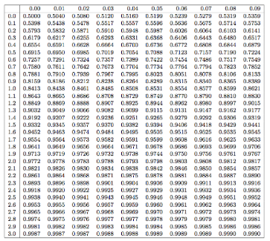
2- Continuous Probability Distributions The Normal Distribution
Normal Table:

Slide 86
2- Continuous Probability Distributions The Normal Distribution
Application:
Given:
Y∼N(25,4)
2- Compute:
P(Y ≥ 30)
P(20 ≤ Y ≤ 30)
P(15 ≤ Y ≤ 20)
P(15 ≤ Y ≤ 30)
2- Find the value “a” given that: P(Y<a)=0.98

Slide 87






2- Continuous Probability Distributions The Normal Distribution
Approximations
Initial distribution | Approximation | Conditions

Slide 88
2- Continuous Probability Distributions Derived Distributions Overview
Sometimes, Normal distribution is not enough:
Testing variance: Chi-Square distribution (χ²)
Testing means: Student’s t distribution
Both depend on degrees of freedom:
df=n−number of parameters estimated

Slide 89


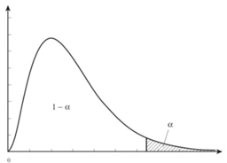

2- Continuous Probability Distributions Derived Distributions Overview
Chi-Square Distribution χ²(n)
Definition
If X₁,…,Xₙ are independent N(0,1):
Then:
Properties
Always positive
NOT symmetric
Mean: E(χ²) = n
Variance: Var(χ²) = 2n
For n ≥ 30:

Slide 90



2- Continuous Probability Distributions Derived Distributions Overview
Chi-Square Table Interpretation
Tables provide values such that:
Example
Find χ² for α = 0.05 and n = 30.
From table:
Thus:
There is a 5% chance that χ² exceeds 43.77.

Slide 91
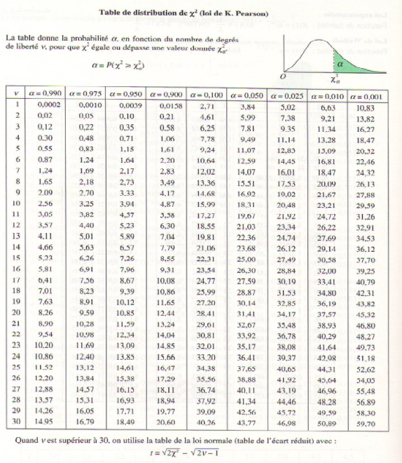
2- Continuous Probability Distributions Derived Distributions Overview

Slide 92

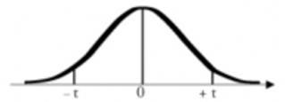
2- Continuous Probability Distributions Derived Distributions Overview
Student’s t Distribution
Definition
Let:
X ~ N(0,1)
Y ~ χ²(n)
Then:
Properties
Symmetric
Mean = 0
Variance = n/(n−2) for n > 2
For n > 30: t(n) ≈ N(0,1)

Slide 93



2- Continuous Probability Distributions Derived Distributions Overview
Student Table Interpretation
Tables provide values such that:
Example
α = 0.05
n = 30
From table:
Then:
Interpretation:
There is a 5% chance that T exceeds 1.697.

Slide 94
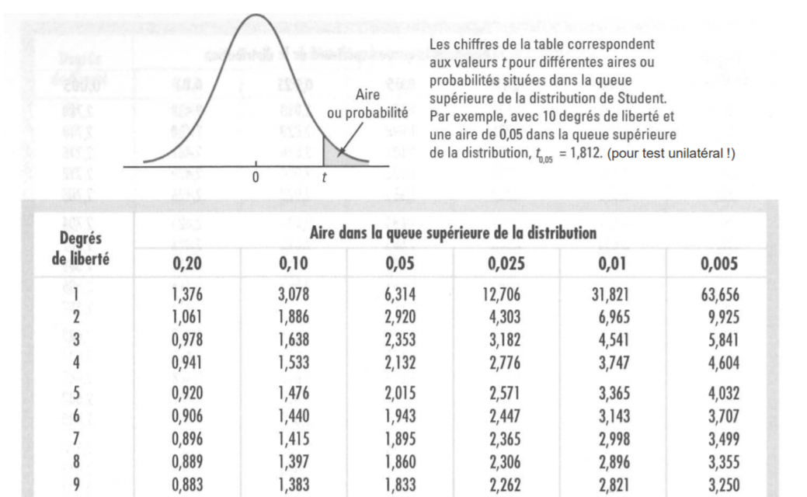
2- Continuous Probability Distributions Derived Distributions Overview

Slide 95
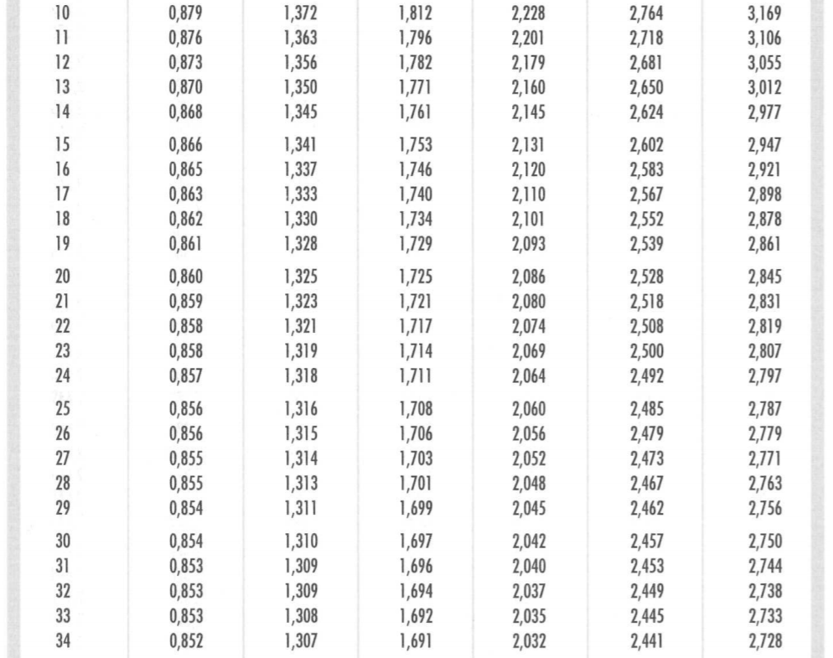
2- Continuous Probability Distributions Derived Distributions Overview

Slide 96
APPLICATIONS

Slide 97
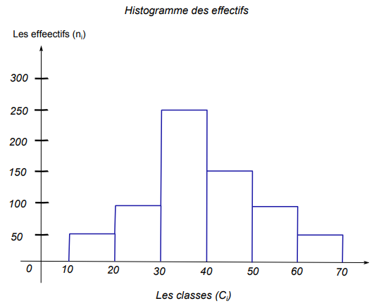
Exercice 1:
At a bus station, passengers’ waiting times are measured in minutes. The histogram below shows the frequencies of this variable.
1- Identify the statistical variable X, its type, and its population.
2- Determine the total number of passengers.
3- From the graph, construct the statistical table.
4- Plot the cumulative distribution function.
5- Determine and interpret the mode.
6- Calculate the median and the mean.

Slide 98
Exercice 2:
A company has a maintenance contract for 300 elevators. It is assumed that, each week, the probability that an elevator breaks down is 1/75
Part A:
We assume independence between breakdowns of the same elevator as well as between different elevators. Let X be the random variable that, for any given week, represents the number of breakdowns in the entire fleet of elevators.
Explain why X follows a binomial distribution and specify its parameters.
Determine the mean, the variance and the standard error.
3. Compute the probability that, during a given week, there are (strictly) fewer than 2 breakdowns.

Slide 99
Exercice 2:
Part B:
We admit that the distribution of X can be approximated by a Poisson distribution with parameter λ. Let Y be a random variable that follows this Poisson distribution.
1- Explain why λ=4.
2- Using the variable Y, compute an approximate value for the probability that the company must intervene fewer than 2 times during a week.

Slide 100
Exercice 2:
Part C:
Consider the random variable Z which, for any adult elevator user selected at random, represents his or her weight in kilograms. We assume that Z follows a normal distribution with mean 70 kg and standard deviation 15 kg.
1- Compute the probability that a randomly selected adult elevator user weighs less than 90 kg.
2- Determine the value a such that P(Z<a)=0.791.

Slide 101
Exercice 3:
A survey conducted among 20 employees of a company, focusing on the amount of monthly transportation expenses (in DT), provided the following information:
198 | 260 | 213 | 276 | 154
189 | 191 | 232 | 166 | 334
209 | 216 | 118 | 348 | 185
176 | 299 | 155 | 145 | 168
1- Determine the statistical population, the sample size, the variable studied and its type, and the categories (modalities).
2- What is the appropriate type of graph for this distribution? Justify your choice.
3- Present the data in a statistical table using class intervals of width 50, starting from [100, 150[.
4- Plot the frequency histogram and the frequency polygon.
5- Calculate the median. Interpret the result.

Slide 102

Merci de votre attention

